Slide 1
How do we know that the Bible is the Word of God?

Slide 2
What do people outside the church say about the Bible?

Slide 3
What do we mean when we say the Bible is the Word of God?
Enderby Chapel Statement of Faith:
We believe the sixty-six books of the Old and New Testaments to be the full record of God’s self-disclosure to mankind. Different men, while writing according to their own styles and personalities, were supernaturally moved along by the Holy Spirit to record God’s very words, inerrant in the original writings. We believe they represent the complete revelation of His Will for the salvation of men and are the divine and final authority in faith, doctrine and life. (2 Timothy 3:16-17; 2 Peter 1:20-21)
Bible means ‘book’. In facts, it is the Book of Books in many respects. When we say that the Bible is the Word of God, we mean that even though the 66 books of the Bible had 40(+) human authors, God was ultimately in control of the message to reveal Himself and his plan to mankind. This is what we call inspiration derived from a Greek word which means ‘God breathed’. This would also mean that the books that were selected to be called scripture in the Old and New testaments are inerrant (without factual mistakes).
In order for us to accept that the Bible is the Word of God, certain things would need to be true about it. The early church used 5 principles when selecting the 27 books that made up the New Testament: 1. Is it authoritative? 2. Is it prophetic? 3. Is it authentic? 4. Is it dynamic? 5. Is it accepted by God’s people? I will add one more for the versions that we use today: Are they reliable? These principals were used to set the Canon of Scripture or the list of books that were included in the Bible.

Slide 5
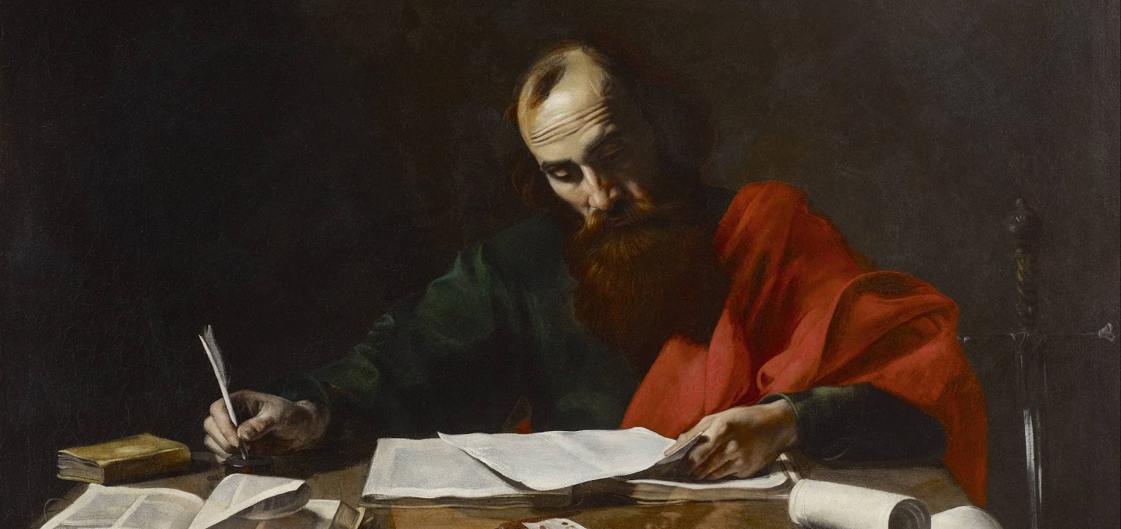

Slide 6
What do we mean when we say the Bible is the Word of God?
Some terms we should know:
Autograph- the original document written by the author, sometimes signed by him.
Copy- an exact facsimile of a document made from the original or another copy.
Transmission- the process relaying the content of an original document to us today.
Manuscript- any written document (often hand written) passed down to us.
Variant- a difference between copies of an original document.
Extant period- the length of time between the autograph and the oldest copy.

Slide 7
What do we mean when we say the Bible is the Word of God?
Three characteristics that must be demonstrated concerning the Bible:
Authenticity of the autographs-
This implies that the Bible is what it claims to be; an accurate eyewitness account of the events surrounding the plan of God leading up to Jesus’ life and ministry. For this to be true the authors must be who they claim to be and their accounts must not contradict each other or be contradicted by other evidence. Another question that bridges the gap between authenticity and reliability is ‘How was the Canon of Scripture set?’ Who decided what books were inspired? Why do we accept the 27 books of the New Testament as authoritative?

Slide 8
What do we mean when we say the Bible is the Word of God?
Three characteristics that must be demonstrated concerning the Bible:
II. Reliability of transmission-
This implies that the Bible that we have today is the same as what was written by the authors of the various books within reason. It must of course be realized that what we use today are translations of copies of the original autographs. This means the accuracy of our Bible is only as good as our translation. We also must accept that minor copying errors have taken place in many of the manuscripts over the nearly two millennia since the books were written. The important question here is; have any of these errors changed the meaning of any passage? Can we compare manuscript copies with each other over time? How good are our translations?

Slide 9
What do we mean when we say the Bible is the Word of God?
Three characteristics that must be demonstrated concerning the Bible:
III. Accuracy of the accounts-
This involves the Bible being factual correct when it refers to people, places and events. Some questions we should ask are: Is the Bible fact or largely fiction? Is there historical or archeological evidence for the people referred to in the Bible? Do the places mentioned really exist and are they as the Bible describes? Is there historical or archeological evidence for the events recorded in the Bible and how does it compare to outside sources? If there is prophecy, did it come true?

Slide 11
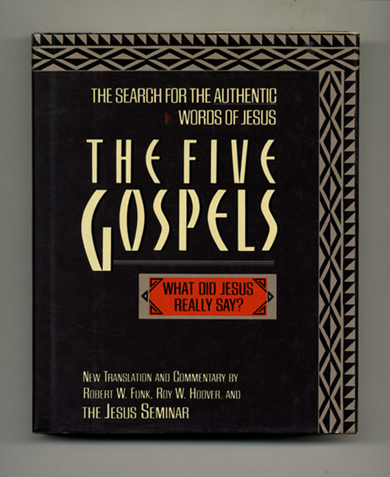
The Authenticity of Scripture:

Slide 12
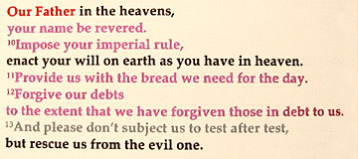

Slide 13
The Authenticity of Scripture:
Can we trust the authorship of the gospels? Did someone else write the gospels?
Many liberal theologians have said that the New Testament books were not written until the late second century. Therefore, none of the gospels or letters found in the New Testament were written by the authors whose names are on them. These theologians provided little in the way of proof for this position but it was accepted by many main line denominations. There is a lot of internal and manuscript evidence to refute this position.
There is no reason to believe that anyone else would have written the gospels. Mark and Luke were relatively unknown and Matthew was not considered to be in the inner circle of disciples. Therefore, there was little or no motive for anyone to use their names to validate the works. John was in the inner circle but his gospel differs significantly from the other three. This would be a problem if it were not clear that it was being written to fill in events and themes that John felt were not covered by the other three gospels.

Slide 14
The Authenticity of Scripture:
Can we trust the authorship of the gospels? Did someone else write the gospels?
Another authentication of the gospel accounts is that the authors died for their work. Tradition holds that Matthew, Mark and Luke were martyred for their faith in Roman persecutions. John died in exile at a Roman penal colony on the island of Patmos. Before this, they had seen many others including the Apostles die horrible deaths at the hands of the Romans for proclaiming the truth about Jesus. They knew the stakes and wrote the gospels anyway. There was no advantage to be gained only martyrdom.

Slide 15
The Authenticity of Scripture:
One of the rules that is accepted by historians is that a document must be considered to be authentic unless there is evidence to prove otherwise. It is like the legal principle of presuming the accused person to be innocent at their trial and placing ‘the burden of proof’ on the prosecutor, in this the historian or critic. The Bible writers claim to be authentic eyewitnesses.
In Lk. 1: 1-4, Luke says of his gospel, “1* Many have undertaken to draw up an account of the things that have been fulfilled among us, 2 just as they were handed down to us by those who from the first were eye-witnesses and servants of the word. 3* Therefore, since I myself have carefully investigated everything from the beginning, it seemed good also to me to write an orderly account for you, most excellent Theophilus, 4 so that you may know the certainty of the things you have been taught”. John says about his message in 1 John 1:3, “3* We proclaim to you what we have seen and heard, so that you also may have fellowship with us. And our fellowship is with the Father and with his Son, Jesus Christ”. 2 Pe 1:16, Peter declares, ‘We did not follow cleverly invented stories when we told you about the power and coming of our Lord Jesus Christ, but we were eyewitnesses of his majesty’.
The New Testament writers claim authenticity and we have no reason to believe otherwise.

Slide 17
The Authenticity of Scripture:
Contradictions:
Do the gospels maintain internal consistency or do they contradict each other? This is a big question because there are obviously many differences between the gospels but are they contradictions. We refer to the first three gospels as the synoptic gospels. Synoptic means ‘with the same vision’. With slight variation, they cover the same events. John’s gospel is obviously written to fill in events and observations that he witnessed that were not recorded in the Synoptics. Anything that he refers to is not a contradiction but an addition that he had the authority to make as an eyewitness. The Synoptic gospels, however, also contain differences in the events, and the order in which they are told. Does this mean that they contradict each other?
It must be remembered that the accounts in the gospels came from different eyewitness sources that saw the events from different standpoints. In a law court, you would expect a variety of witnesses to vary slightly in their testimony. If they didn’t you would become suspicious that they had coordinated their stories to convince the court. The minor variations are not contradictions but different perspectives and emphases of the authors that actually make their testimony more believable.

Slide 19
The Reliability of Scripture:
Accuracy of Transmission
The transmission of Biblical books is as important to the authority of the Bible as whether it was inspired by God. If the Bible was transmitted throughout the generations in a sloppy or careless manner, then its content is not a reliable foundation on which to build our faith. Critics would not even consider a source that had obvious errors of transmission or that had been deliberately changed by those that came centuries after the events related.
Fortunately, there is a lot of evidence that the transmission of the Bible has been extremely accurate. There is no ancient literature that has been so carefully or accurately transmitted as the Bible. The Jews had come up with ways of determining the accuracy of every manuscript. If a copy failed any of the tests, it was discarded. These techniques were passed on to early church. Accuracy was a spiritual necessity because they were copying God’s inspired words and changing them would be blasphemy and bring God’s curse. This sort of concern for accuracy was not present when most other ancient documents were copied.

Slide 20
The Reliability of Scripture:
Short Extant Period
Another area that sets the Bible apart from other ancient writings is the very short extant periods of the various Biblical books. The extant period refers to the time span between the author writing the book and the oldest copy that is in existence. A short extant period means that there is less chance for the text to be changed or corrupted.
For the New Testament, the extant period is approximately from 25-80 years depending on the book. The nearest extant period for an ancient writing is Homer’s Illiad. It’s extant period is 500 years. See the chart attached. Many of the ancient classics have extant periods over 1000 years but are considered reliable by scholars. The same scholars question the reliability of the Bible.

Slide 22
The Reliability of Scripture:
Large Number of Ancient Manuscripts
The Bible also has a large number of early manuscripts that have survived. When all the early manuscripts in Greek, Latin and other languages are counted there are over 24,000 of them. This does not the include the many fragments of papyrus manuscripts some of which date to the 1st century. Other ancient books only have a handful of existing copies to compare.
When the thousands of manuscripts are compared, you do find variants but most of these are the same in different families of copies indicating that the variant was just copied over and over. Most of these variants are minor difference in word use that does not affect the meaning of the sentences involved. A very small number of variants affect the meaning of a sentence (only 40 lines) but none of these affect a major doctrine. Some of the best surviving manuscripts of the New Testament come from the Alexandrian scripts. These were commissioned by the Emperor Constantine after the Council of Nicea in 310 AD under the direction of the bishops of all the churches. They were intended to represent the accepted version of the Bible. Codex Sinaticus, Codex Alexandrinus and Codex Vaticanus are considered to be the best preserved of these.

Slide 23
The Reliability of Scripture:
The Canon
The Canon of scripture is an issue for many critics. How can a collection of books chosen by church leaders in the 4th century be accepted as God’s infallible word? What were their reasons for including the books that they did? Why did they leave certain books out? The Canon of Scripture was set at a church council in 393 AD called the Synod of Hippo. In reality, it was a gathering of church leaders from all over the world who came together to recognize as scriptural all those books that had already been accepted by Christian for over three centuries. As Geisler and Nix wrote, “Canonicity is determined … by God; it is merely discovered by man”. (McDowell. A Ready Defense. P. 38). They also stated that five principles were used to determine what was scripture: 1. Is it authoritative? 2. Is it prophetic? 3. Is it authentic? 4. Is it dynamic? 5. Is it accepted by God’s people?
There are a variety of reasons that other books were left out. They were historically and geographically inaccurate. They taught doctrines that were false and contradicted previous scripture. They are obvious of false authorship (pseudepigraphal). They lack the authority and prophetic nature of other parts of scripture.

Slide 24
Were Some Books Left Out Of The Bible?

Slide 25
Is the Old Testament Reliable?

Slide 26
The Accuracy of the Bible: Old Testament
On the walls of the Temple of Karnak in Egypt, there is an inscription from the 10th century BC referring to a military campaign in Palestine that is also described in 1 Kings 14:24,25. The inscription also mentions a place called the Field of Abram in the Hebron area referring to the Patriarch Abraham, who was well enough known that Egyptians would refer to him by name.
50 people mentioned in the Old Testament have been verified through archeology.
The Nuzi tablets from the second millennium BC found in Northern Iraq confirm many of the social customs that were practiced by the patriarchs. The practice of a wife giving her maid to her husband to have children is specifically mentioned in marriage contracts.
In 1974, 17,000 clay tablets were discovered from the Ancient city-state of Ebla dating from around 2300 BC. The tablets refer to the five ‘Cities of the Plain’ that are mentioned in Genesis 14.

Slide 27
The Accuracy of the Bible: Old Testament
The Cyrus Cylinder from Ancient Persia records Cyrus’ order to allow the captives to return home and rebuild their temple. The Bible says the same thing in 2 Chronicles 36:23 and Ezra 1:2-4: "This is what Cyrus king of Persia says: "The LORD, the God of heaven, has given me all the kingdoms of the earth and he has appointed me to build a temple for him at Jerusalem in Judah. Anyone of his people among you--may the LORD his God be with him, and let him go up.”
1 Kings 9:15-17 states that Solomon fortified the cities of Megiddo, Hazor and Gezer mentioning them alongside the “chariot cities”. The Bible says he had 1400 chariots and 12,000 horses (or horsemen). Interestingly archeologists at Megiddo have discovered two royal stable complexes that had the capacity to hold 480 horses. There may be other stables not yet excavated. The stables discovered held two horses per stall, which is unusual unless the horses work together as a team… as on a chariot! Also, at Megiddo, Hazor and Gezer excavations have revealed complex city gates from the 10th century BCE built on identical plans. This demonstrates that they were built around the same time by the same builder. These gates are commonly called, “Solomonic Gates”.

Slide 28
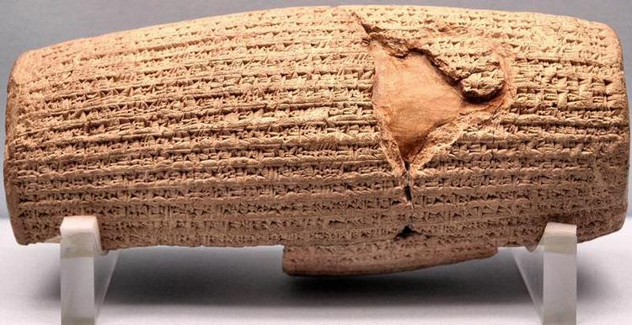
The Cyrus Cylinder

Slide 29
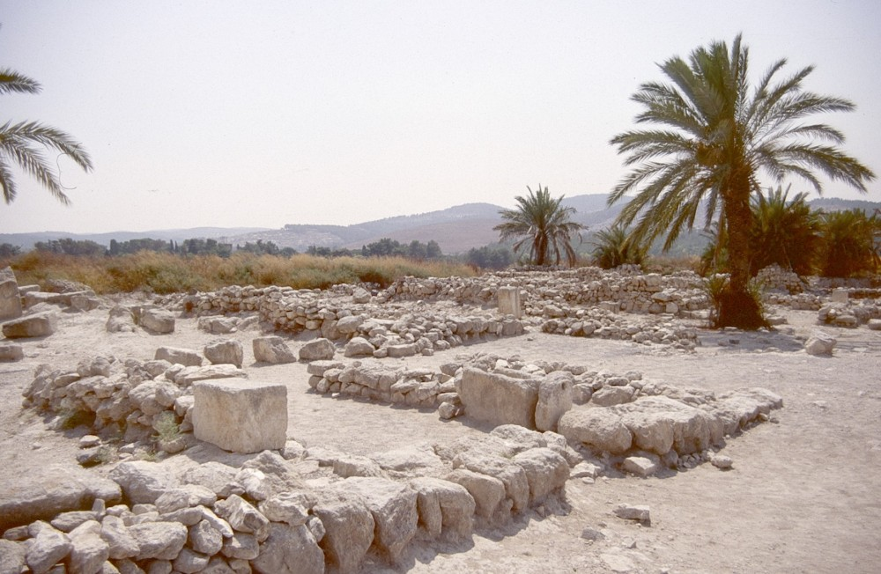
Solomon’s stables at Megiddo

Slide 30
The Accuracy of the Bible: Old Testament
The existence of Belshazzar, king of Babylon, was once doubted by critics. Belshazzar is named in Daniel 5, but according to the non-Biblical historic record, the last king of Babylon was Nabonidus. Tablets have been discovered, however, describing Belshazzar as Nabonidus’ son and documenting his service as coregent in Babylon. If this is the case, Belshazzar would have been able to appoint Daniel “third highest ruler in the kingdom” for reading the handwriting on the wall (as recorded in Daniel 5:16). This would have been the highest available position for Daniel. Here, once again, we see the historicity of the Biblical record has been confirmed by archaeology.
Skeptics once denied the existence of Kings David and Solomon, or believed them to be very minor tribal leaders, if they existed at all. In 1994, however, archaeologists discovered a stele (a monumental stone slab) near Tel Dan in Northern Israel. It dates to the ninth century before Jesus, and was apparently placed in this location to celebrate the victory of the Aramean king over the armies of Israel. Importantly, it bears an inscription which refers to the “House of David,” confirming the fact that David reigned and established a dynasty.

Slide 31
The Accuracy of the Bible: Old Testament
The historicity and cultural customs of the Patriarchs have been corroborated in clay tablets uncovered in the cities of Nuzi, Mari and Bogazkoy. Archaeological discoveries in these three cities have confirmed the existence of the Hittites. These findings also revealed an example of an ancient king with an incredible concentration of wealth. Prior to this discovery, skeptics doubted such ancient affluence was possible and considered the story of Solomon to be greatly exaggerated. This discovery provided an example of such a situation, however. Solomon’s prosperity is now considered to be entirely feasible.
The historicity of the Assyrian king, Sargon (recorded in Isaiah 20:1) has also been confirmed, despite the fact his name was not seen in any non-Biblical record. Archeology again proved the Biblical account to be true when Sargon’s palace was discovered in Khorsabad, Iraq. More importantly, the event mentioned in Isaiah 20, Sargon’s capture of Ashdod, was recorded on the palace walls, confirming the history recorded in Old Testament Scripture. Fragments of a stela (an inscribed stone pillar) were also found at Ashdod. This stela was originally carved to memorialize the victory of Sargon.

Slide 32
The Accuracy of the Bible: Old Testament
Archaeologists investigating the southern part of the wall surrounding Jerusalem’s Old City found a dump dated to the eighth century BC. It contained many clay imprints and seals, and one of these displayed the “Belonging to Hezekiah (son of) Ahaz king of Judah.” On an additional seal discovered at the site, archaeologists found an inscription that said, “Yesha ‘yah[u].” In Hebrew, this means, “YHWH is salvation,” but in English the name inscribed here is “Isaiah.” Some experts believe this is evidence of the Biblical prophet, Isaiah, given the close proximity of the two seals and the connection between Hezekiah and Isaiah in the Old Testament narrative.
The Taylor Prism is a 6 sided clay inscription made for the Assyrian King, Sennacherib. It chronicled Sennacherib’s military campaigns including one against Hezekiah, the king of Judah. Sennacherib took many cities in Judah but could not defeat Jerusalem even after a long siege. The events are found in II Kings 19:36-37 and Isaiah 37:36-37. In the Biblical account, the Angel of Death destroyed the Assyrian army and forced them to withdraw. Herodotus, the famous ancient Greek historian also mentioned the siege and said that an army of field mice attacked the Assyrians and ate all the leather straps on their armour.

Slide 33
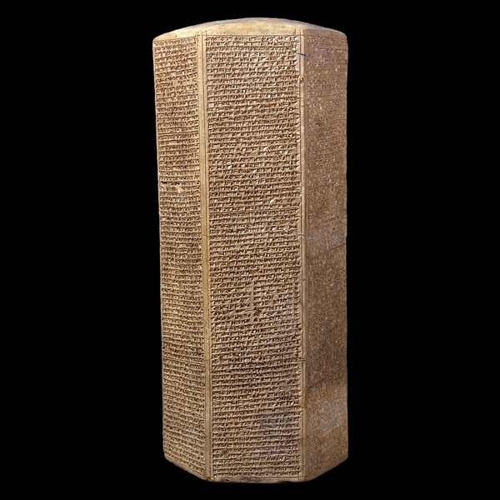
Taylor Prism: Sennacherib’s Annals

Slide 35
The Accuracy of the Bible: New Testament
Just like with the Old Testament, historical sources, archeological discoveries and geographical accuracy underlines the credibility of the New Testment.
A. Sir William Ramsay, a famous archeologist from the turn of the century, believed that the Gospel of Luke and the Book of Acts were written in the 2nd century and, therefore, contained many historical and geographical errors. He set out to find archeological evidence to support his assumption. Every time he investigated a fact stated in Luke, he found evidence in the form of inscriptions or details of the layout of ancient cities that proved Luke’s account of events. In the end he totally changed his position and stated, ‘Luke is a historian of first rank; not merely are his statement of fact trustworthy. This author should be placed along with the very greatest of historians’. Ramsey began using the Bible as a guide for his explorations.

Slide 36
External Evidence for the Gospel of Luke

Slide 37
The Accuracy of the Bible: New Testament
B. Luke says that Quinirius was Governor of Syria at the time of Jesus’ birth. Luke 2:1-5 says,
1* In those days Caesar Augustus issued a decree that a census should be taken of the entire Roman world. 2* (This was the first census that took place while Quirinius was governor of Syria.) 3* And everyone went to his own town to register. 4* So Joseph also went up from the town of Nazareth in Galilee to Judea, to Bethlehem the town of David, because he belonged to the house and line of David. 5* He went there to register with Mary, who was pledged to be married to him and was expecting a child.
But Josephus says that Quinirius became Governor in 6 AD, too late for the birth of Jesus. Ramsey found an inscription that indicates that Quinirius was governor of Syria in 7 BC just in time for Jesus’ birth. Historians now accept that Quinirius was governor twice. Luke’s description of the census matches exactly with a papyrus from the time that gives instructions for conducting a census.

Slide 38
The Accuracy of the Bible: New Testament
C. Hostile sources confirm the Biblical accounts- Tacitus, a Roman historian who wrote his Histories around 115 AD, wrote about Nero’s use of Christians as a scapegoat for the fire of Rome to divert attention away from him. Christians are described as followers of Jesus who was crucified by Pontius Pilate and believers in a ‘pernicious superstition’. This implies their claims that Jesus rose from the grave. Tacitus is even more believable because he is a hostile source.
Thallus and Phlegon, both first century historians make mention of the eclipse of the sun that took place when Jesus was crucified. They also mention that it should not have happened according to astronomers because it was a full moon at the time.
Suetonius, another Roman historian, wrote about the Reign of Claudius, “Since the Jews constantly made disturbances at the instigation of Chrestus, he expelled them from Rome.” And also about the Reignof Nero; “Punishment was inflicted on the Christians, a class of men given to a new and mischievous superstition.”

Slide 39
Historical Evidence for the New Testament

Slide 40
The Accuracy of the Bible: New Testament
D. Flavius Josephus, a Jewish Roman historian and one of the best sources of information about first century Palestine, wrote in The Antiquities about the death of James who is identified as ‘the brother of Jesus who was called the Christ’. Josephus also wrote about Ananias, the high priest and Festus, the Roman governor that Paul was brought before in the Book of Acts.
There is a more controversial passage by Josephus in the Testimonium Flavianum that refers directly to Jesus. Josephus calls him a wise man that performed miracles and won over many Jews and Greeks to His teachings. He also confirms that the Romans with the collaboration of the Jewish leaders put Jesus to death.
Josephus also provides a lot of background to the conflict between Pilate, Herod and the Jewish leadership that helps us to understand the events that surrounded the trail and crucifixion of Jesus.

Slide 41
The Accuracy of the Bible: New Testament
E. Archeology and the New Testament
In Romans 16:23, Paul refers to Erastus, the city treasurer of Corinth. In 1929, a paving stone was dug up in Corinth that said, “Erastus, the curator of public buildings laid this pavement at his own expense”.
The existence of Pilate was doubted until an inscription was found in 1961 in Caesarea Maratima that read, “ Pontius Pilate, Prefect of Judea, has presented the Tiberium to the Caesareans”. They also found a ring bearing Pilate’s name in the Herodium, Herod’s Palace near Bethlehem.
In 1990 two burial caves were discovered on a hill immediately south of Jerusalem. They contained twelve loculi (Hebrew kokhim) and four ossuaries. Two of the ossuaries were inscribed with forms of the name Qayapa’, or Caiaphas, a family name familiar from the New Testament and from the first-century historian Josephus. One member of the Caiaphas family served as high priest from 18 CE to 36/37 CE; he was in office during the public career of Jesus and presided at his trial. Though the New Testament refers to him only by his family name, his personal name, Joseph, is mentioned by Josephus (Jewish Antiquities 18.35).

Slide 43
